Slide 1
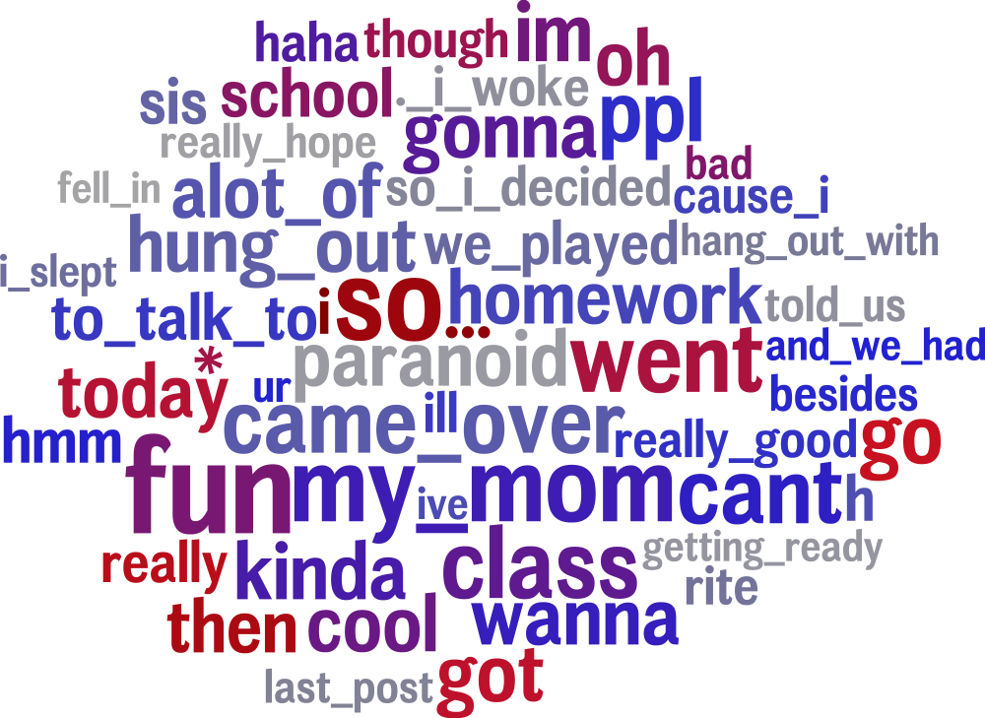
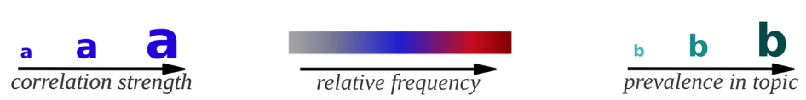
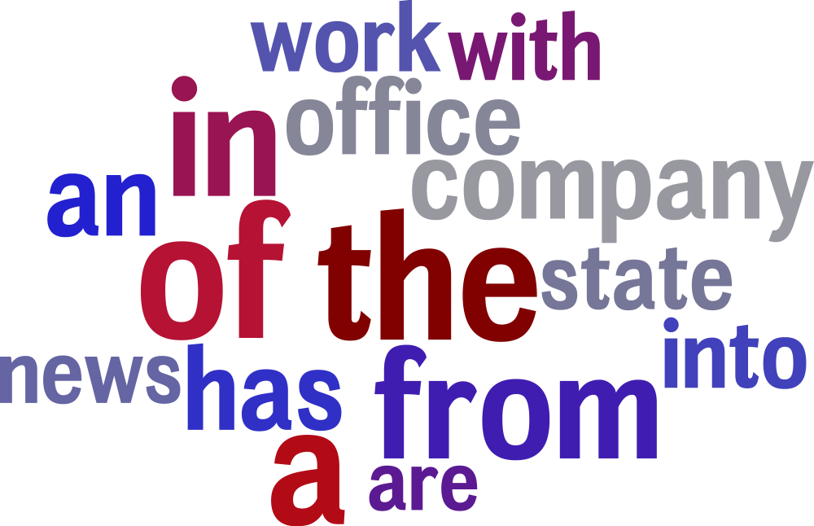
Student language (β = .11 to .21)
Non-student language (β = .12 to .21)
All language features shown are significant at p = .05, Benjamini-Hochberg corrected for multiple comparisons. Size indicates correlation strength, color indicates frequency (increasing in relative frequency from grey to blue to red)

Slide 2
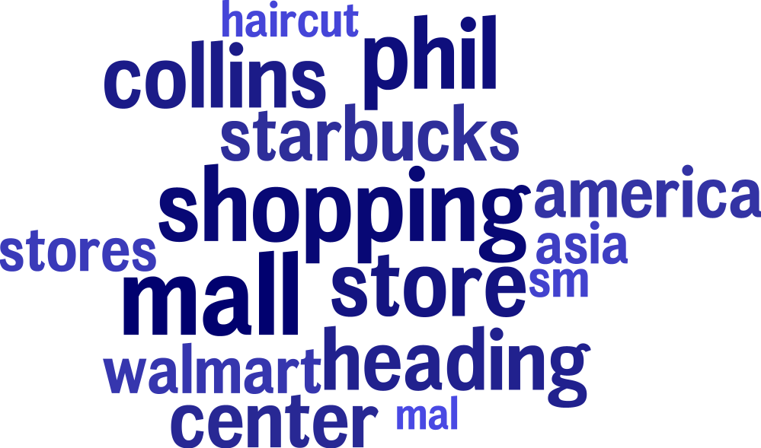
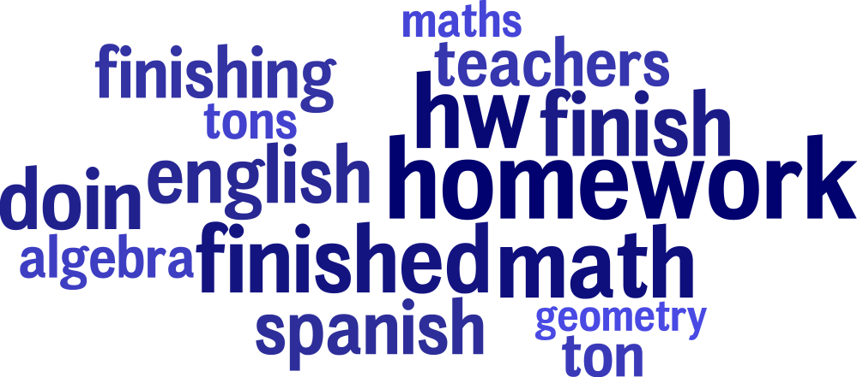
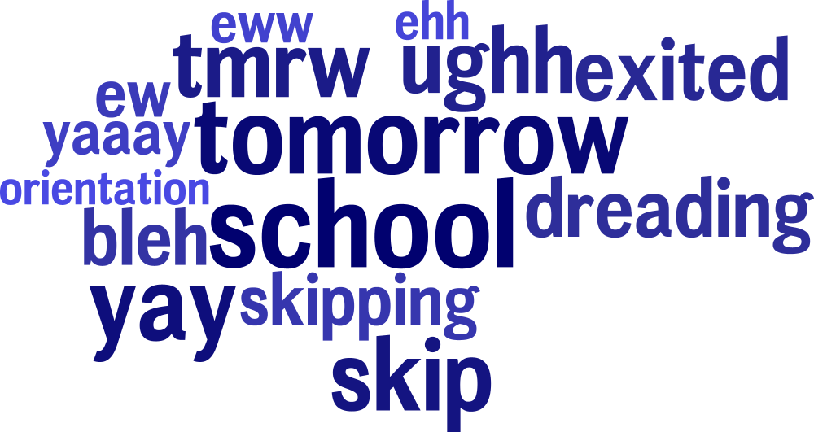
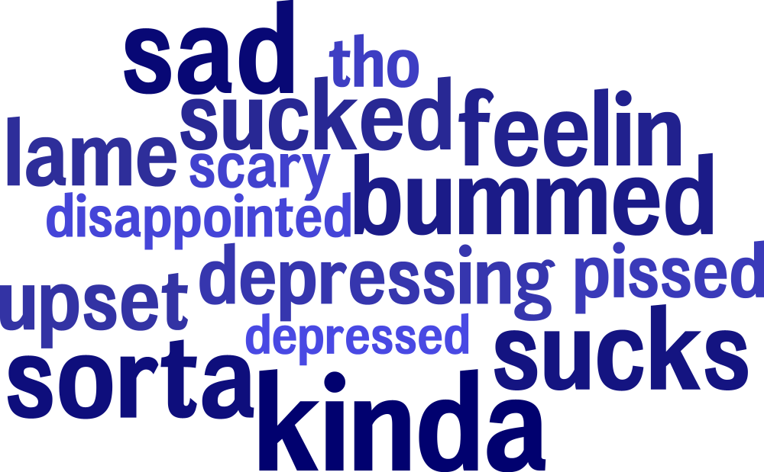
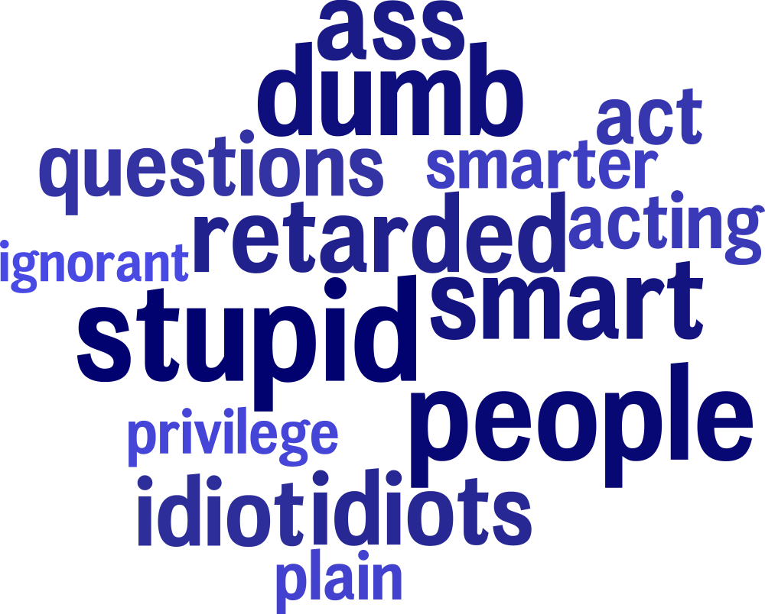
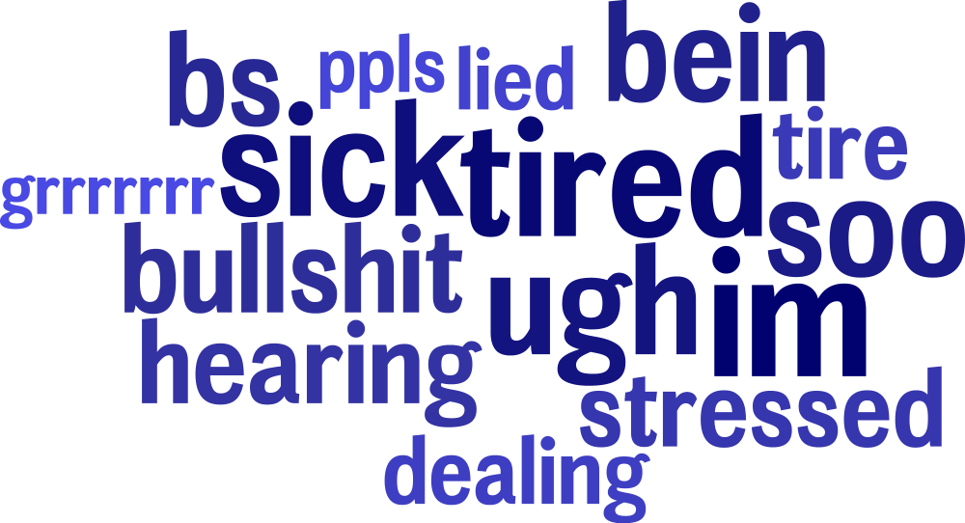
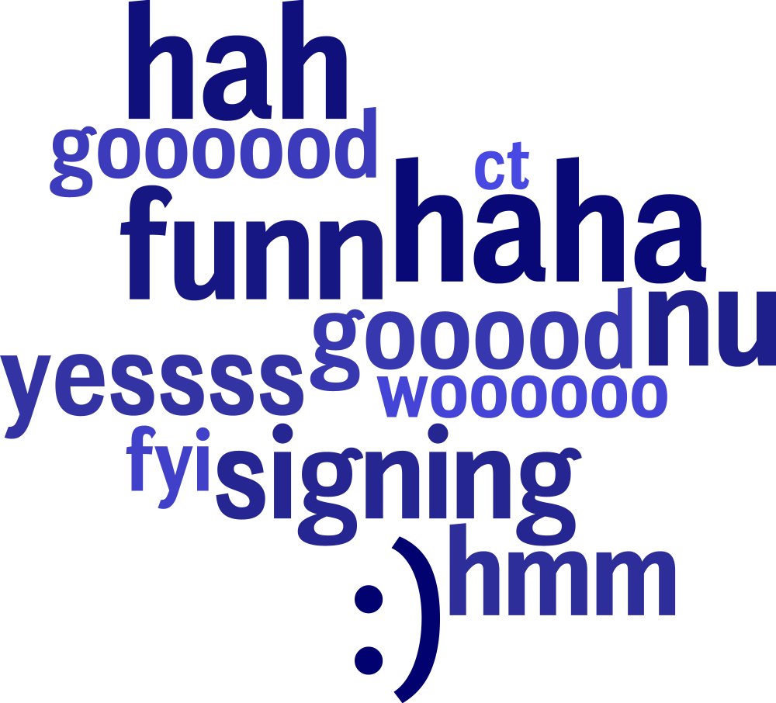
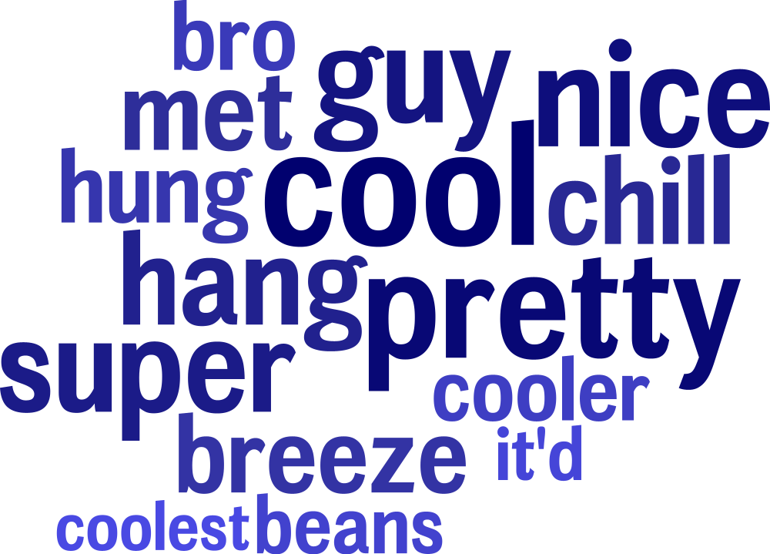
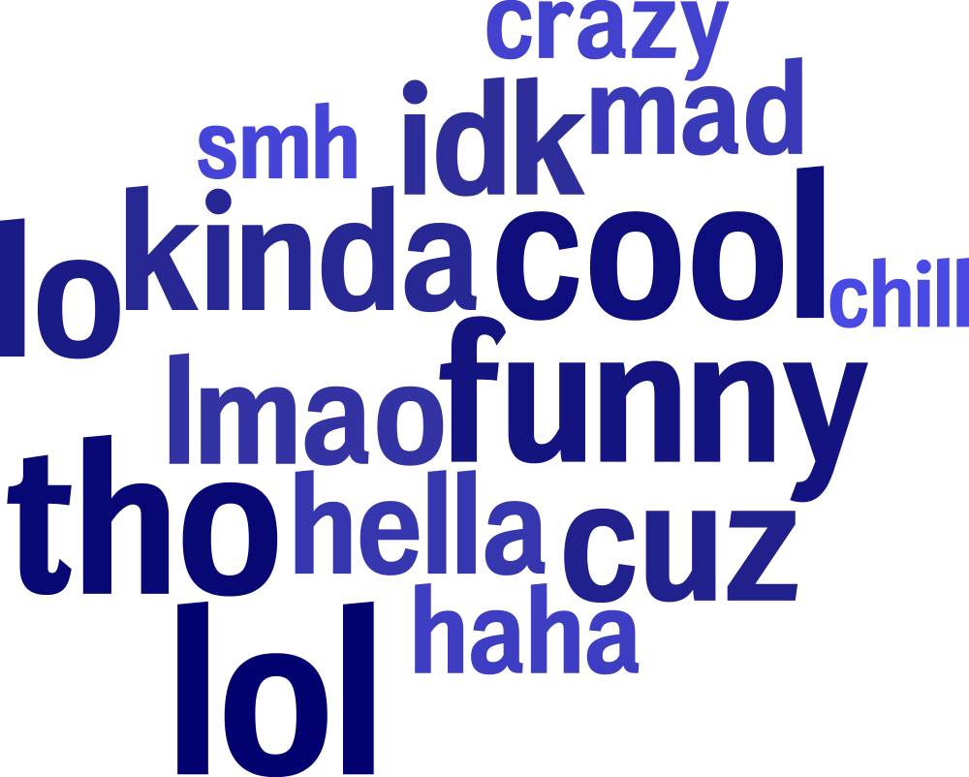
Student
Activities
(β = .13 to .21)
Negative
Affectivity
(β = .13 to .20)
Informal
Language
(β = .14 to .20)
All language features shown are significant at p = .05, Benjamini-Hochberg corrected for multiple comparisons (separately for topics, dictionaries and 1to3grams). Words size in topics indicates prevalence in topics in descending order, color is random for readability.

